Slide 1
Continuous prediction with regression

Slide 2
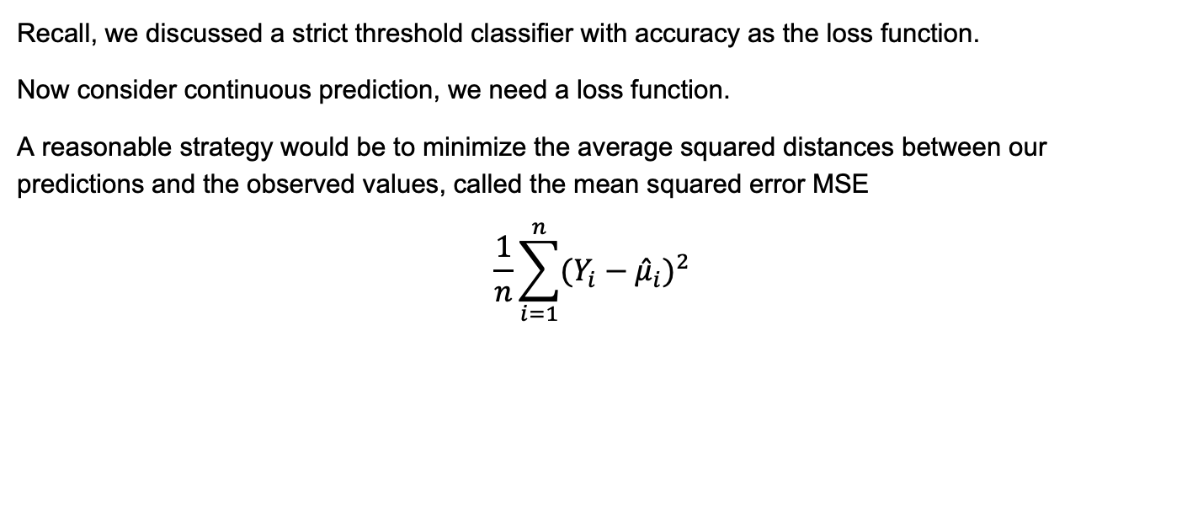
Background
Recall, we discussed a strict threshold classifier with accuracy as the loss function.
Now consider continuous prediction, we need a loss function.
A reasonable strategy would be to minimize the average squared distances between our predictions and the observed values, called the mean squared error MSE
$$\frac{1}{n}\sum_{i=1}^{n}{{(Y_{i}−{\hat{μ}}_{i})}^{2}}$$

Slide 3
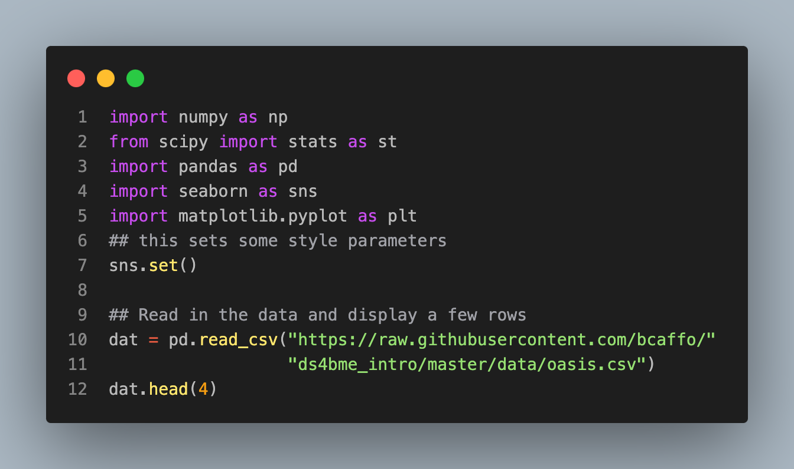

Regression line
How to produce ${\hat{μ}}_{i}$, our predictions for the observation $Y_{i}$?
We previously considered just a rescaled version of $X$, our predictor, using regression through the origin.
Consider a slightly more complex model that includes a location (intercept) shift and a scale factor (slope)
To tie ourselves down with an example, consider the previous lecture's example, consider trying to get the FLAIR value from the other, non-FLAIR, imaging values.

Slide 4
 | FLAIR | PD | T1 | T2 | FLAIR_10 | PD_10 | T1_10 | T2_10 | FLAIR_20 | PD_20 | T1_20 | T2_20 | GOLD_Lesions
0 | 1.143692 | 1.586219 | -0.799859 | 1.634467 | 0.437568 | 0.823800 | -0.002059 | 0.573663 | 0.279832 | 0.548341 | 0.219136 | 0.298662 | 0
1 | 1.652552 | 1.766672 | -1.250992 | 0.921230 | 0.663037 | 0.880250 | -0.422060 | 0.542597 | 0.422182 | 0.549711 | 0.061573 | 0.280972 | 0
2 | 1.036099 | 0.262042 | -0.858565 | -0.058211 | -0.044280 | -0.308569 | 0.014766 | -0.256075 | -0.136532 | -0.350905 | 0.020673 | -0.259914 | 0
3 | 1.037692 | 0.011104 | -1.228796 | -0.470222 | -0.013971 | -0.000498 | -0.395575 | -0.221900 | 0.000807 | -0.003085 | -0.193249 | -0.139284 | 0

Slide 5
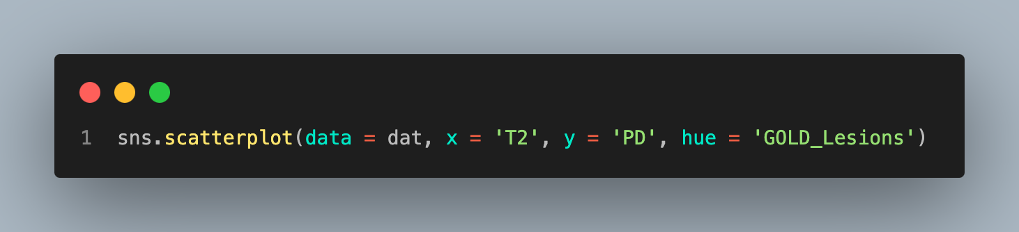
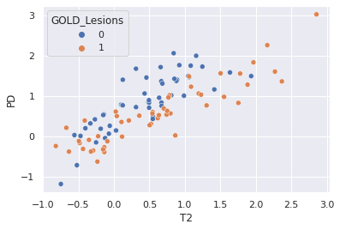

Slide 6
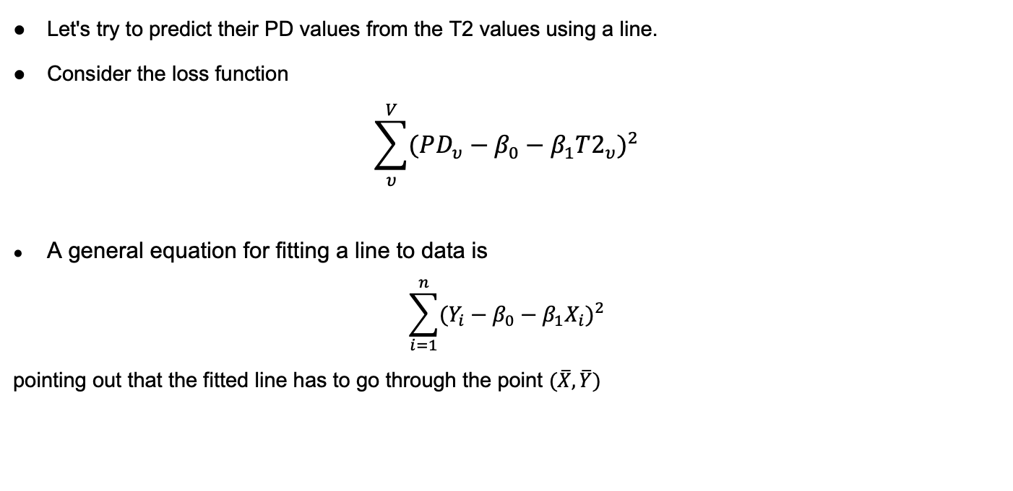
Regression lines
Let's try to predict their PD values from the T2 values using a line.
Consider the loss function
$$\sum_{υ}^{V}{{(PD_{υ}−β_{0}−β_{1}{T2}_{υ})}^{2}}$$
A general equation for fitting a line to data is
$$\sum_{i=1}^{n}{{(Y_{i}−β_{0}−β_{1}X_{i})}^{2}}$$
pointing out that the fitted line has to go through the point $(\overline{X},\overline{Y})$

Slide 7
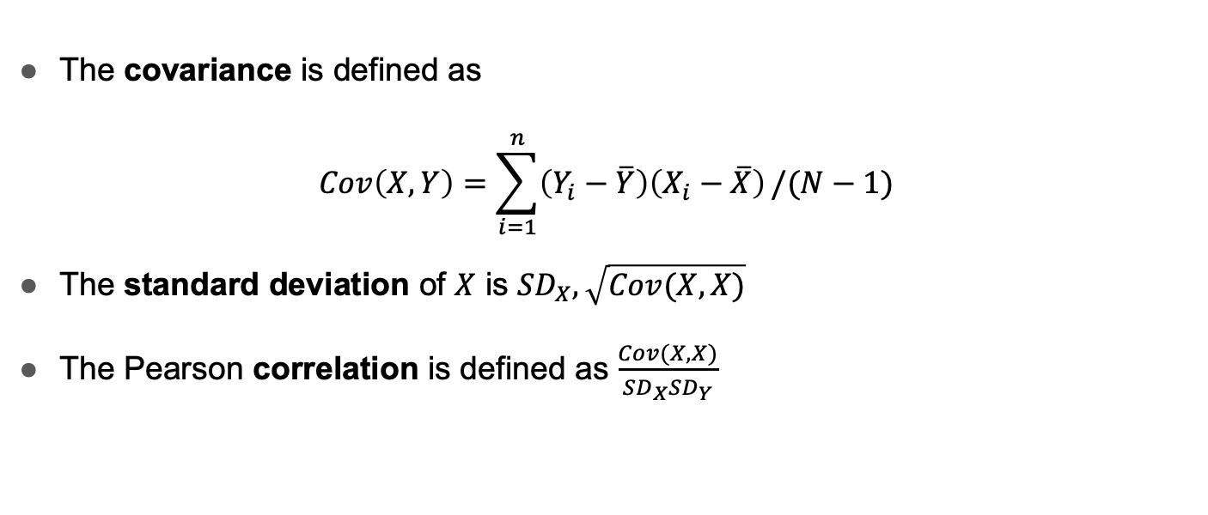
Some definitions
The covariance is defined as
$$Cov\left(X,Y\right)=\sum_{i=1}^{n}{\left(Y_{i}−\overline{Y}\right)\left(X_{i}−\overline{X}\right)}/(N−1)$$
The standard deviation of $X$ is ${SD}_{X},\sqrt{Cov(X,X)}$
The Pearson correlation is defined as $\frac{Cov(X,X)}{{SD}_{X}{SD}_{Y}}$

Slide 8
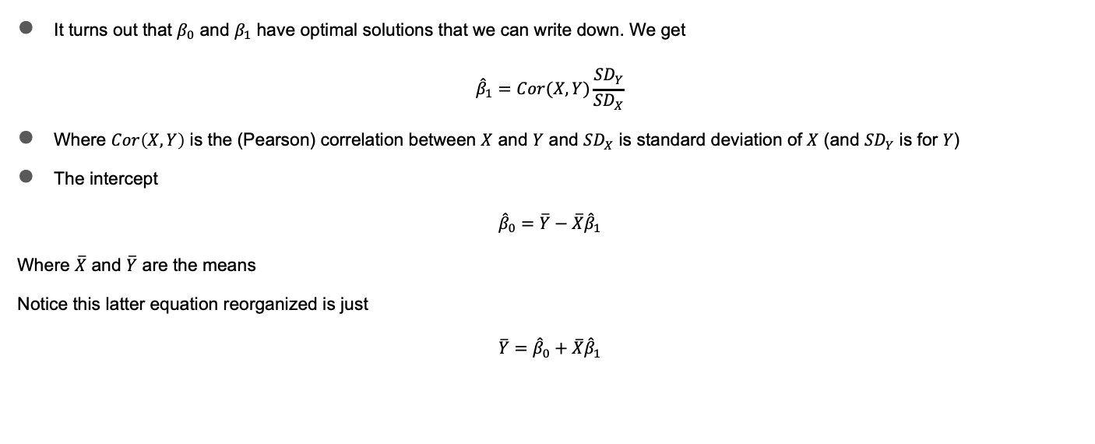
General solution
It turns out that $β_{0}$ and $β_{1}$ have optimal solutions that we can write down. We get
$${\hat{β}}_{1}=Cor(X,Y)\frac{{SD}_{Y}}{{SD}_{X}}$$
Where $Cor\left(X,Y\right)$ is the (Pearson) correlation between $X$ and $Y$ and ${SD}_{X}$ is standard deviation of $X$ (and ${SD}_{Y}$ is for $Y$)
The intercept
$${\hat{β}}_{0}=\overline{Y}−\overline{X}{\hat{β}}_{1}$$
Where $\overline{X}$ and $\overline{Y}$ are the means
Notice this latter equation reorganized is just
$$\overline{Y}={\hat{β}}_{0}+\overline{X}{\hat{β}}_{1}$$

Slide 9
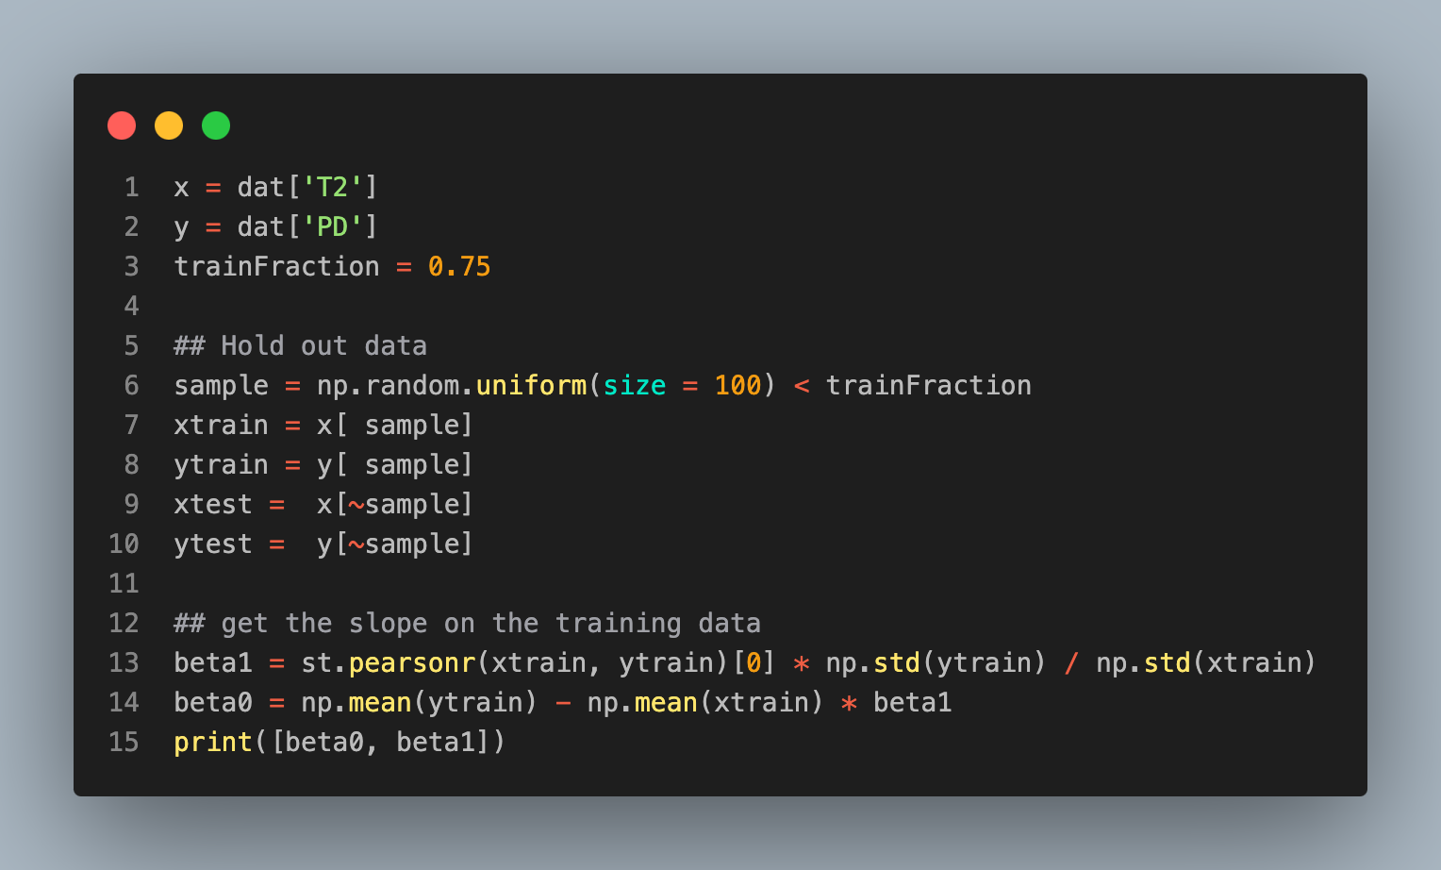
Trying it out on the data
[0.261176099, 0.824533638141]

Slide 10
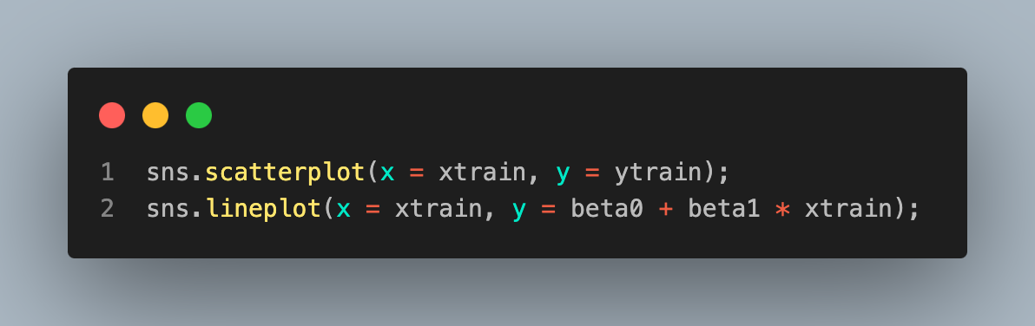
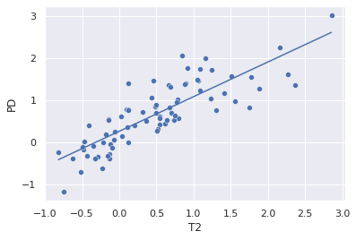

Slide 11
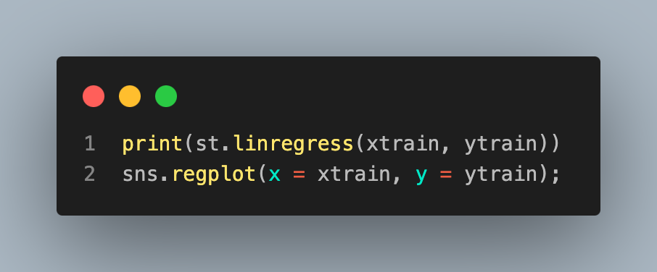
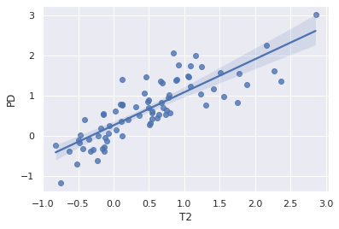
LinregressResult(slope=0.824533638141543, intercept=0.26117609936409997, rvalue=0.8299829203407062, pvalue=5.891957127333846e-21, stderr=0.06356268302127861, intercept_stderr=0.0583790090295795)

Slide 12
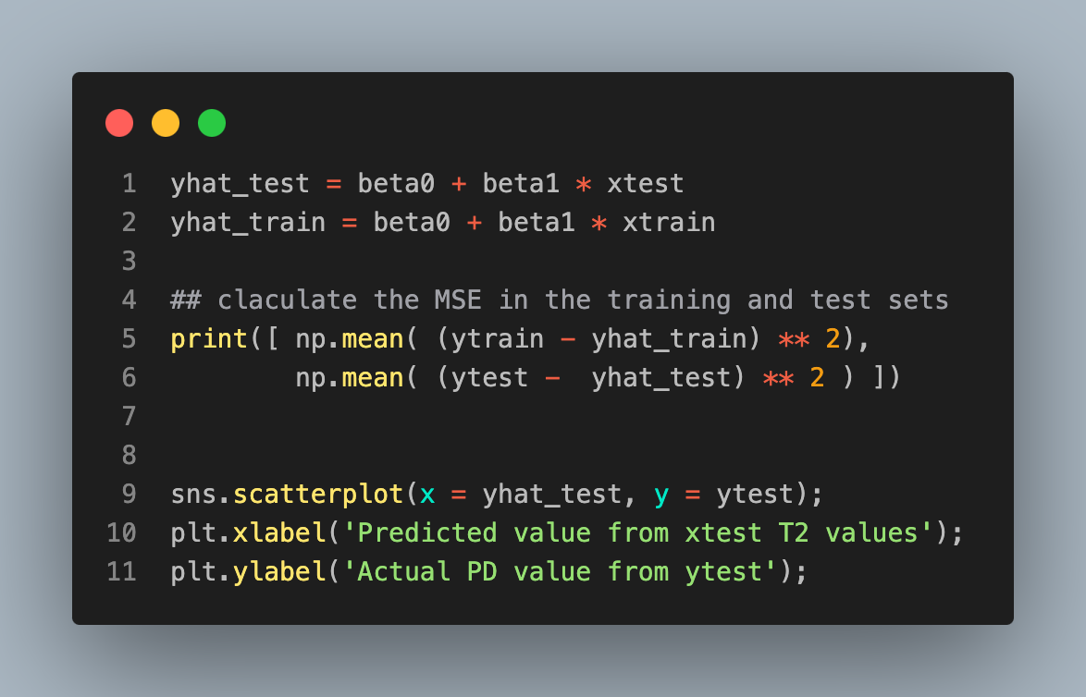
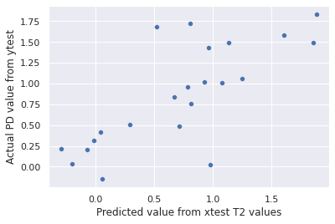
Predictions
[0.1819649506412, 0.2018159354760]

